Slide 1
Object Oriented Programming in Python

Slide 2
Object-oriented programming (OOP) is a programming paradigm based on the concept of "objects".
The object contains both data and code:
Data in the form of properties (often known as attributes), and code, in the form of methods (actions object can perform)
OOP concepts include encapsulation, polymorphism, and inheritance.

Slide 3
An object has the following two characteristics:
  Attributes
  Behaviors(methods)
For example, A Car is an object,
  Its model, price, and color are its attributes
  breaking, acceleration are its behavior(methods)
Think of attributes as characteristics/properties that an object is or has
Think of behavior(methods) as the tasks the object can perform or can do

Slide 4
A Class is a blueprint for your object.
It is referred to as a blue print because :In a class Properties of an object are represented as variables, and the methods represent the object’s actions and behaviors.
An Object can also be referred to as an instance of a class and the making of an object from a class is called instantiation
Thus object oriented programming allows us to work with instances of a class(objects)

Slide 5
Class Attributes and Methods
As we defined a Class, attributes can be defined into two parts:
  Instance variables: The instance variables are attributes attached to an instance of a class. We define instance variables in the constructor ( the __init__() method of a class).
  Class Variables: A class variable is a variable that is declared inside of class, but outside of any instance method or __init()__ method.

Slide 6
Inside a Class, we can define the following three types of methods.
  Instance method: Used to access or modify the object attributes. If we use instance variables inside a method, such methods are called instance methods.
  Class method: Used to access or modify the class state. In method implementation, if we use only class variables, then such type of methods we should declare as a class method.
  Static method: It is a general utility method that performs a task in isolation. Inside this method, we don’t use instance or class variable because this static method doesn’t have access to the class attributes.

Slide 7
Constructors in Python
In Python, a constructor is a special type of method used to initialize the object of a Class.
The constructor will be executed automatically when the object is created. If we create three objects, the constructor is called three times to initialize each object.
The main purpose of the constructor is to declare and initialize instance variables. It can take at least one argument that is self. The __init()__ method is called the constructor in Python. In other words, the name of the constructor should be __init__(self).

Slide 8
Encapsulation in Python
Encapsulation is a method of wrapping data and functions into a single entity.
For example, A class encapsulates all the data ( methods and variables).
Encapsulation means the internal representation of an object is generally hidden from outside of the object's definition.
Encapsulation restricts accessing variables and methods directly and prevent accidental data modification by creating private data members and methods within a class.

Slide 9
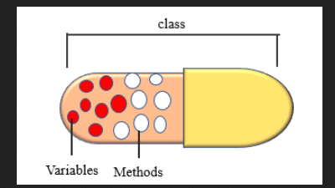

Slide 10
Encapsulation offers a way for us to access the required variable without providing the program full-fledged access to all variables of a class. This mechanism is used to protect the data of an object from other objects.
Encapsulation can be achieved by declaring the data members and methods of a class either as private or protected.
We can achieve this by using single underscore and double underscores.

Slide 11
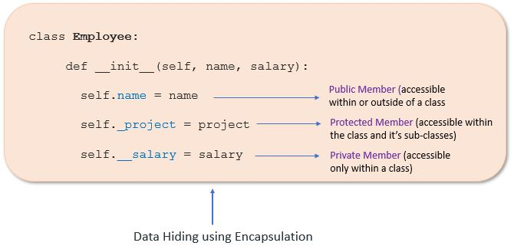
Access modifiers limit access to the variables and methods of a class. Python provides three types of access modifiers
  Public Member: Accessible anywhere from outside the class.
  Private Member: Accessible within the class
  Protected Member: Accessible within the class and its sub-classes

